Slide 1
OGUARD62’s
Visual Tutorial for “Method of Play”

Slide 2
overview
Pre-game Setup
Introduction of “Oguard62 Locators”
Kicking Game
Neutral Downs
Trick Play
Situational Downs
Conclusion

Slide 3
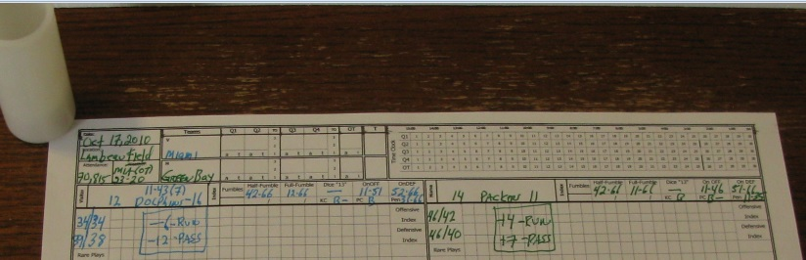
Pre-Game Setup
Offense Index: Miami (34/34) Green Bay: (46/42)
Defensive Index: Miami 39/38 Green Bay: (46/40)
Sack/Int Rating: Miami 12/-16 Green Bay: (14/11)
Half Fumble Rating: Miami 42-66 Green Bay: 42-66
Full Fumble Rating: Miami 12-66 Green Bay: 11-66
Fumble Recovery (Offense) : 11-51 Green Bay: 11-46
Fumble Recovery (Defense) :52-66 Green Bay: 51-66
Kick Coverage Rating: Miami B- Green Bay: B
Punt Coverage Rating: Miami B Green Bay: B-
Penalty Rating: Miami 36-66 Green Bay: 11-35

Slide 4
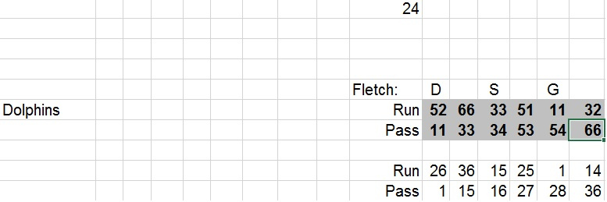
Pre-Game Setup
Using “INPUT” tab of “Oguard62 Locators” spreadsheet
  Enter Fletch67 rating for each team

Slide 5
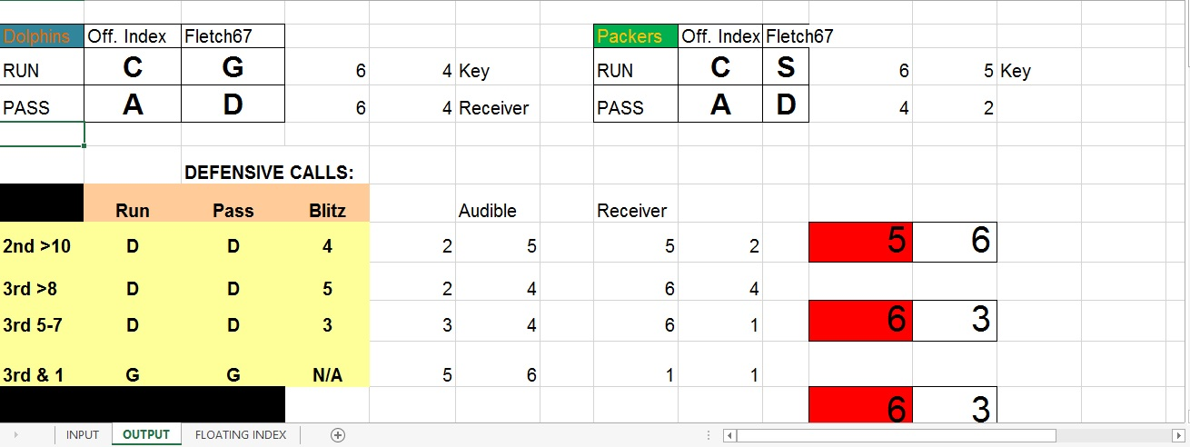
OGUARD62 LOCATORS
Use on Neutral Downs to determine offensive index & defense’s Fletch rating
Offensive index is determined by “Offensive Index Finder System”
If defense is in “D” against the pass or “G” against the run, check for an audible. Determine intended receiver.
Situational Down & Distance Table
Additional Dice Rolls

Slide 6
  KICKING GAME

Slide 7
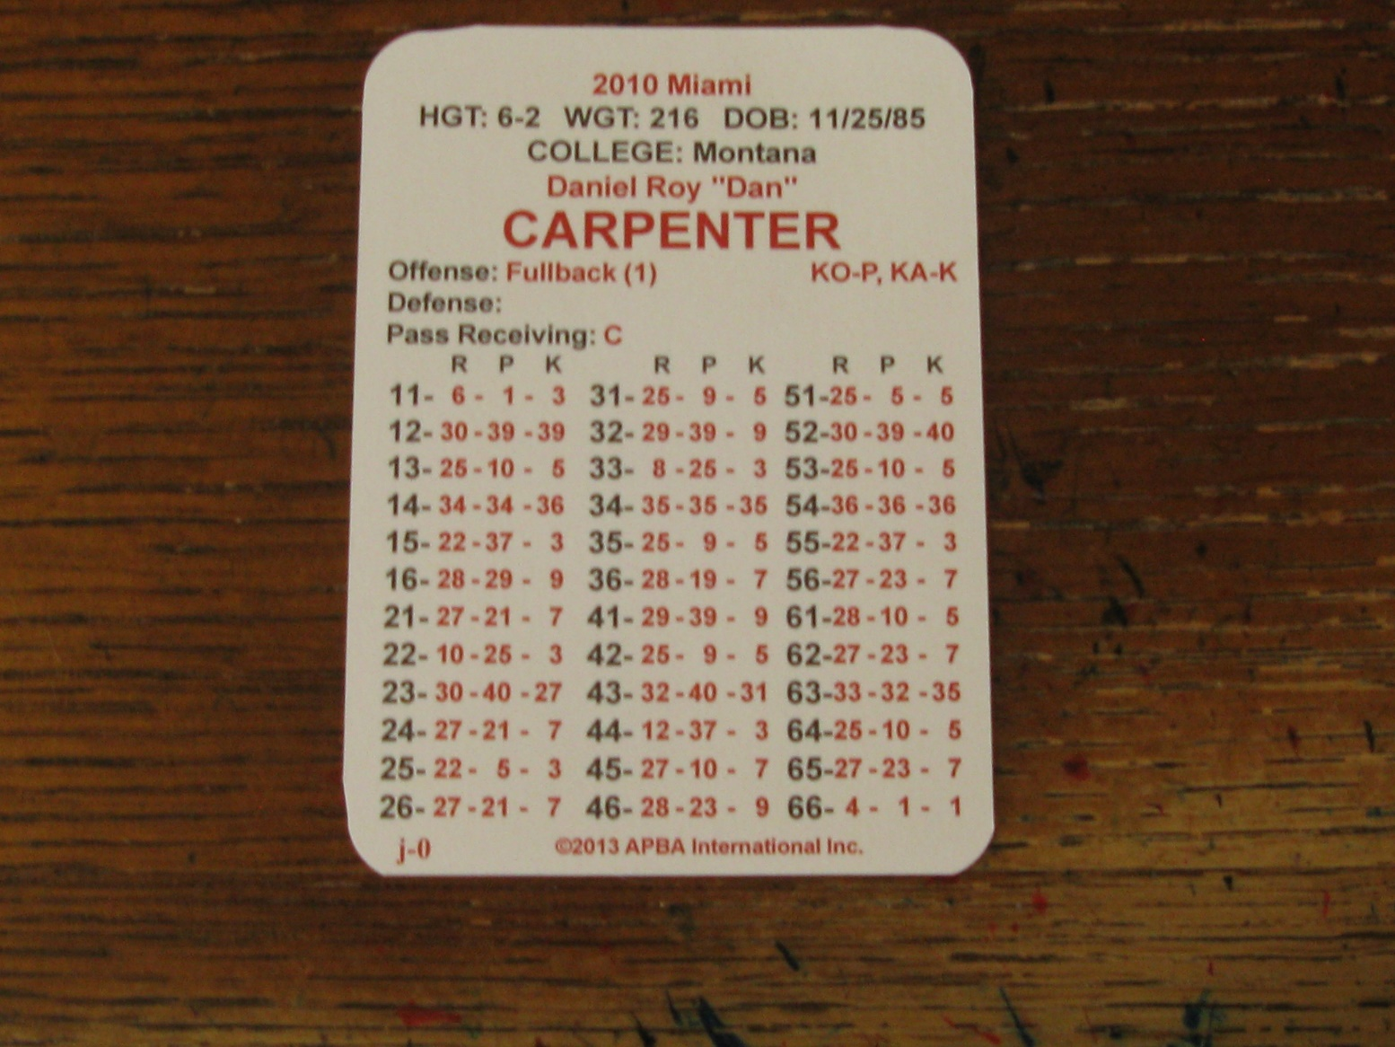
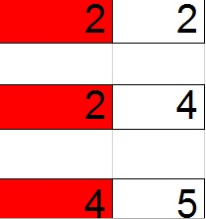
Kick Off
Kick off Dice Roll
Resulted in Play Result “25” which is a Touchback. No time off the game clock.
KO – indicates “Kickoff Specialist” –P – Read dice roll from “P” Column

Slide 8
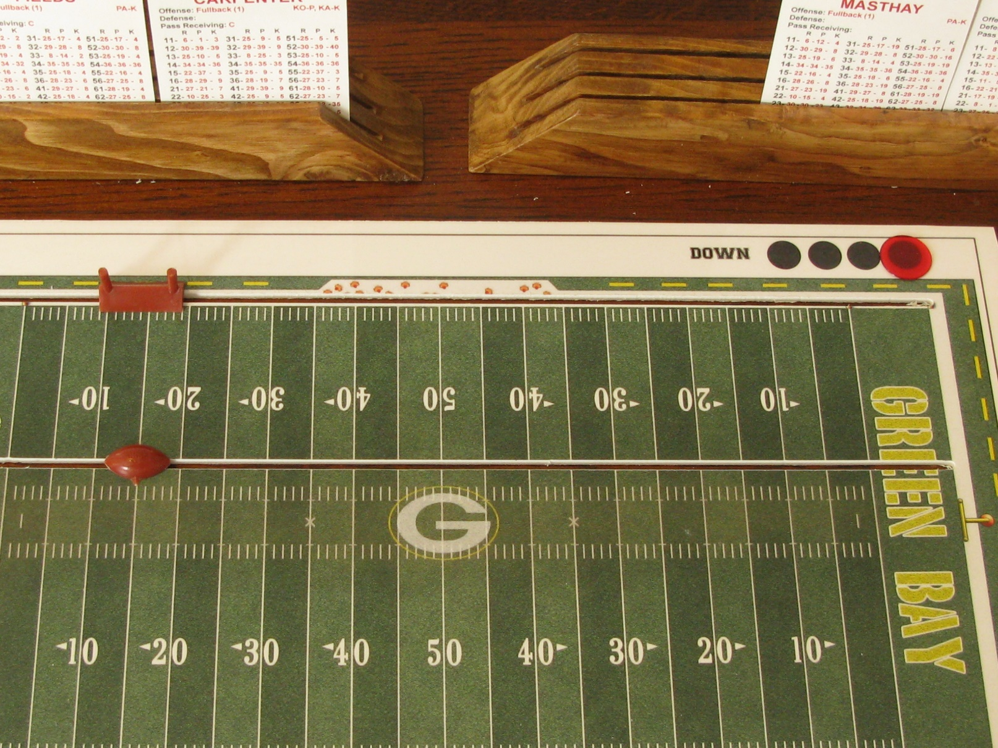
Field Goal Attempt
Green Bay opening drive stalled at the Miami 15-yard line. Mason Crosby trots out onto the field to attempt a 32-yard field goal attempt.
Always add 17-yards to the attempt to account for the goal post location (10 yards) and the long snap (7 yards).

Slide 9
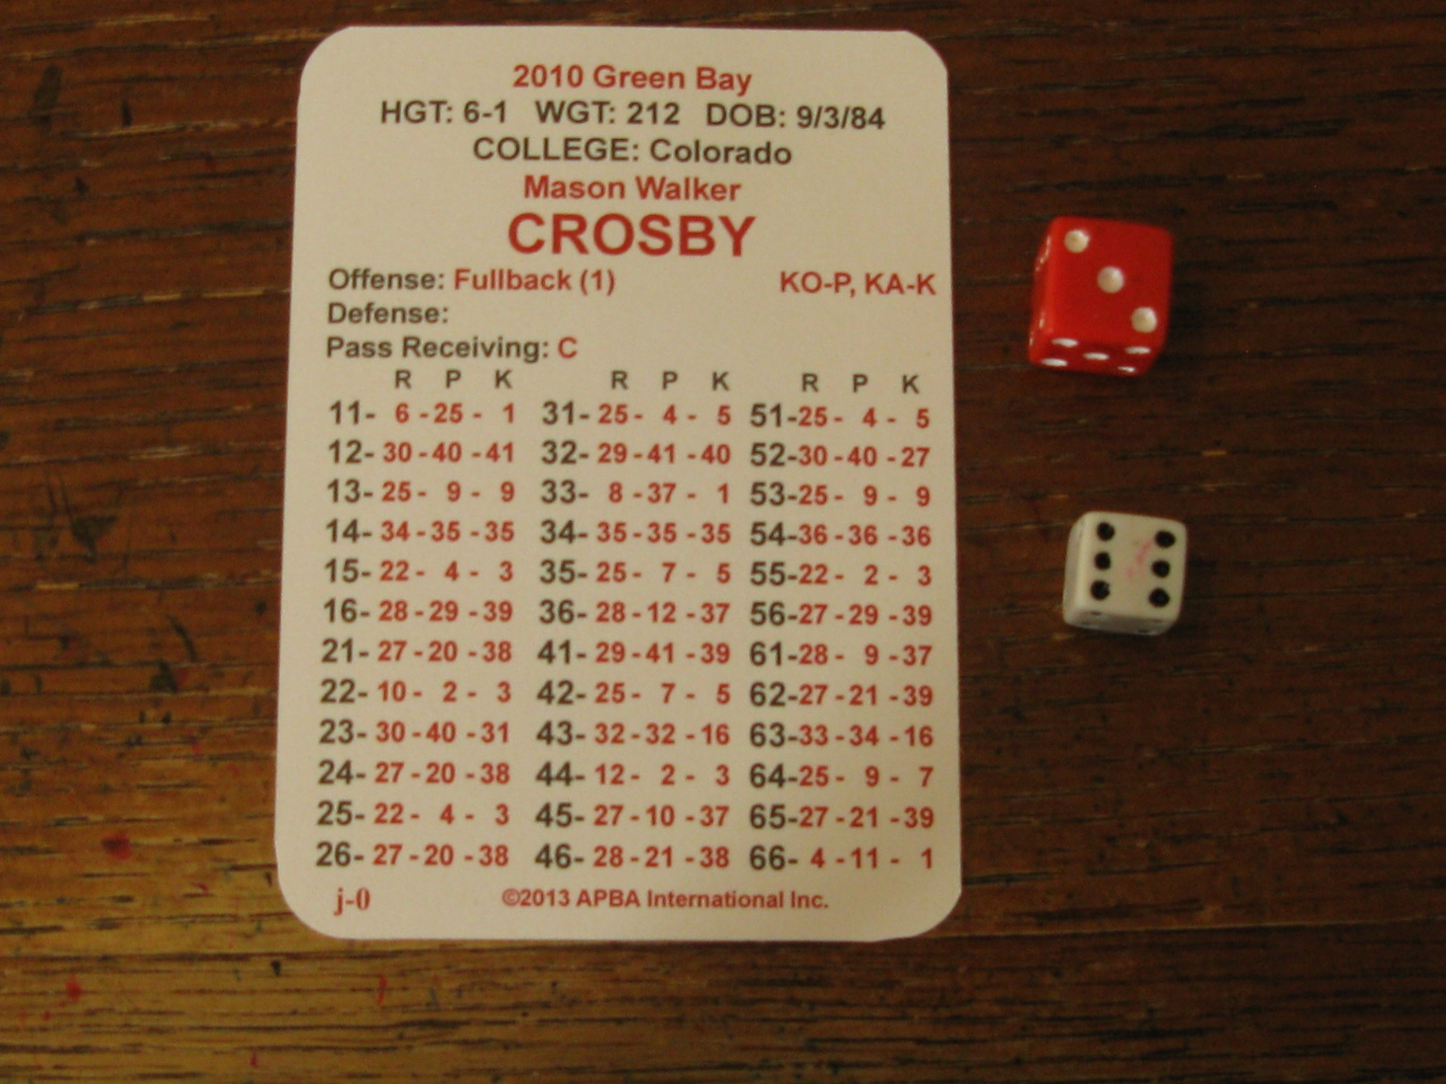
Field Goal Attempt
Dice Roll
The play result is “37”.
KA - indicates Primary Place Kicker. “– K” indicates the column to read result from.

Slide 10
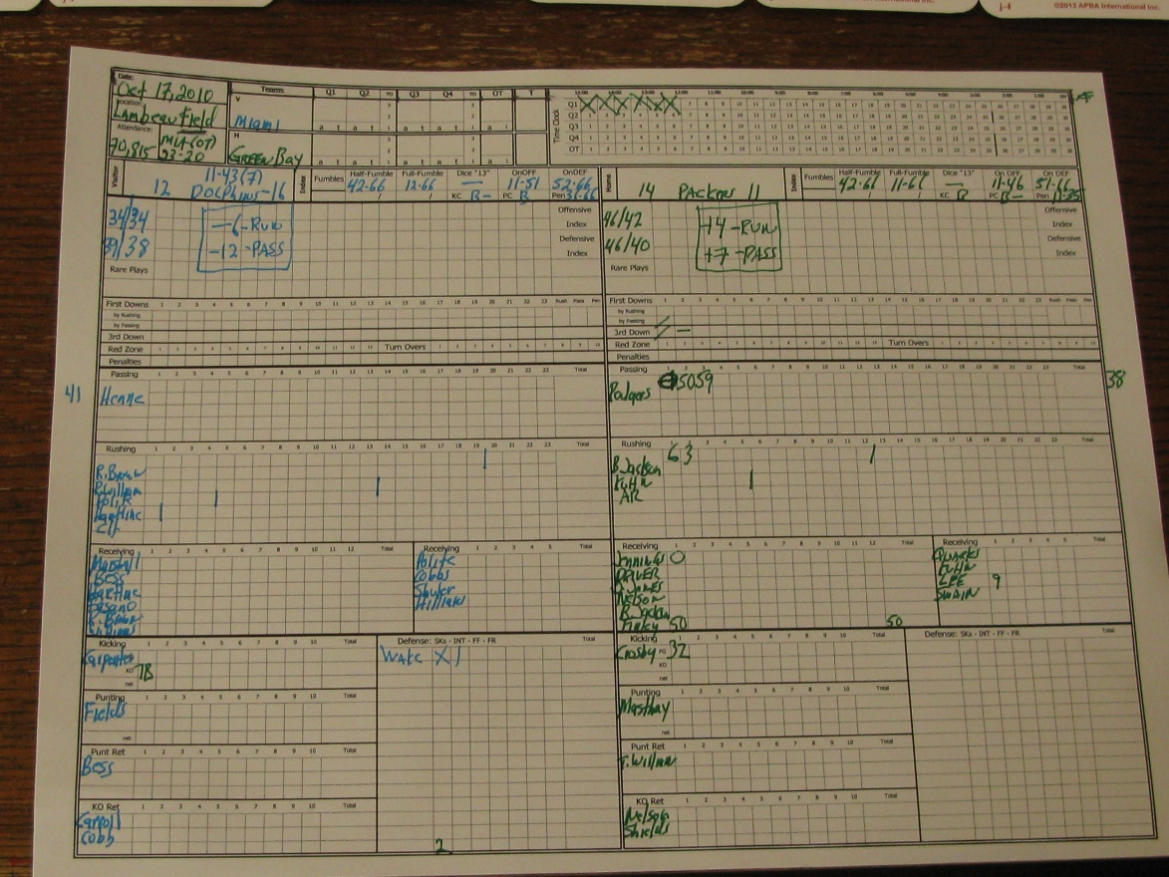
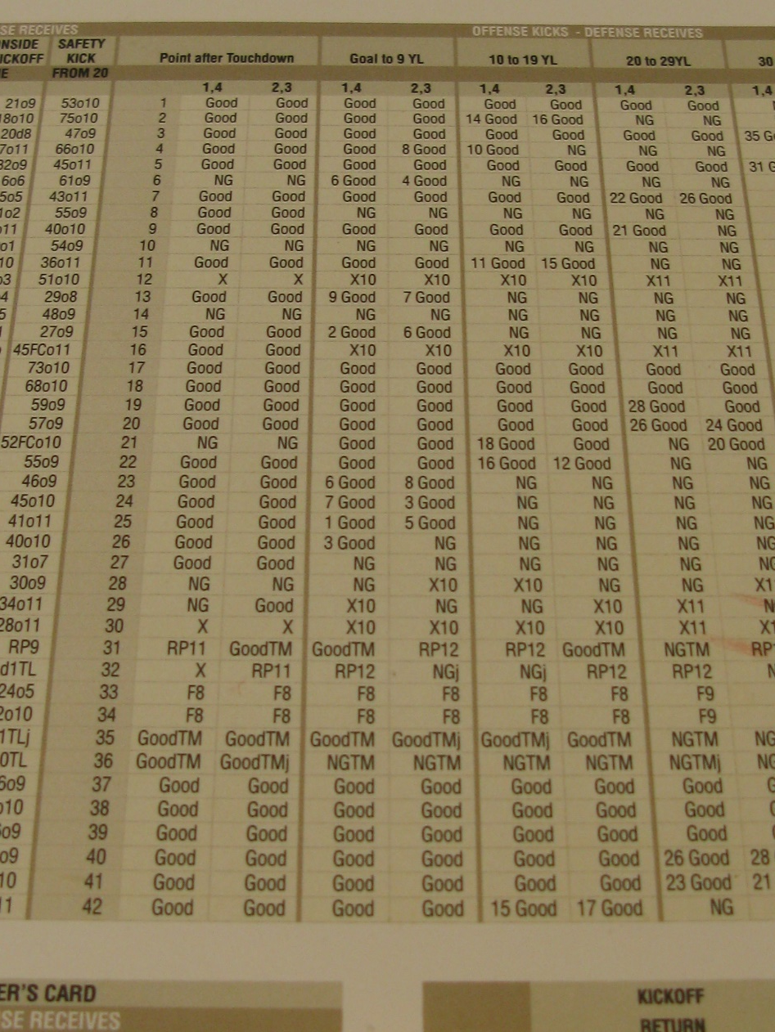
Field Goal Attempt
Annotate scoring play on back side of scoresheet (GB – FG Crosby 32). Annotate statistics on score sheet.

Slide 11
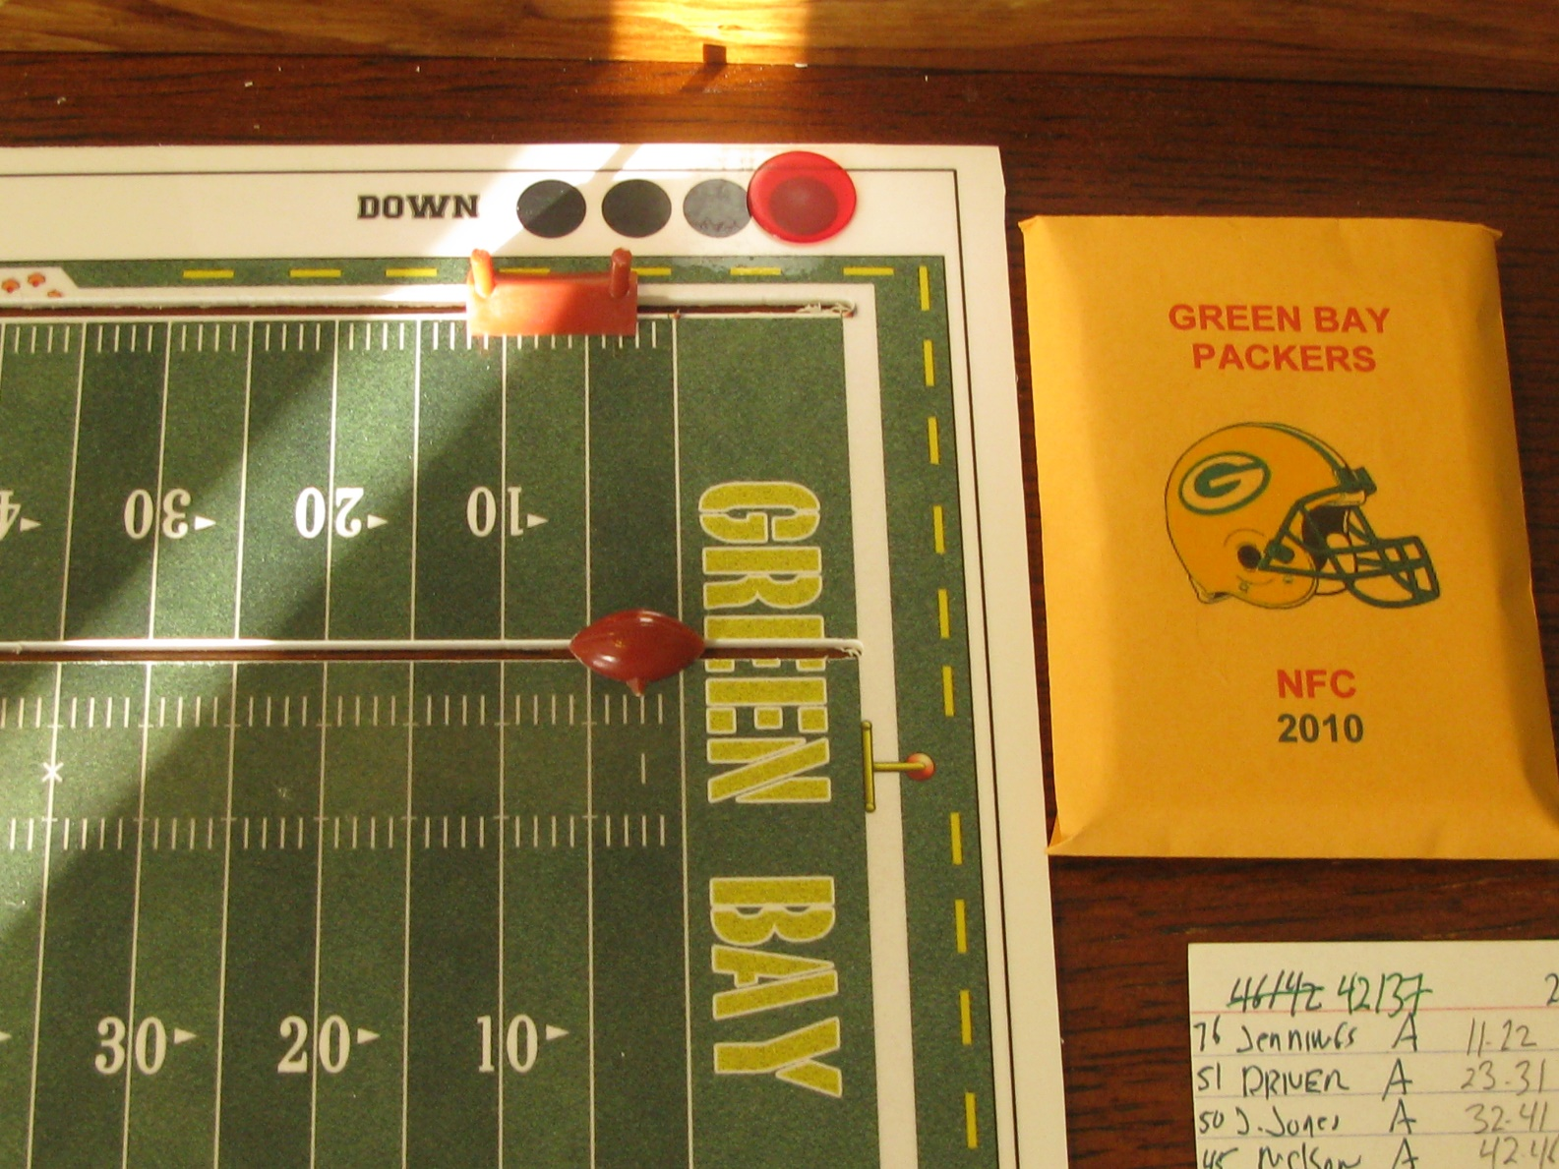
Punt
Green Bay got pinned at their own -2 to begin their second offensive series.
Miami forced a three and out.
Masthay was forced to punt from his own endzone.

Slide 12
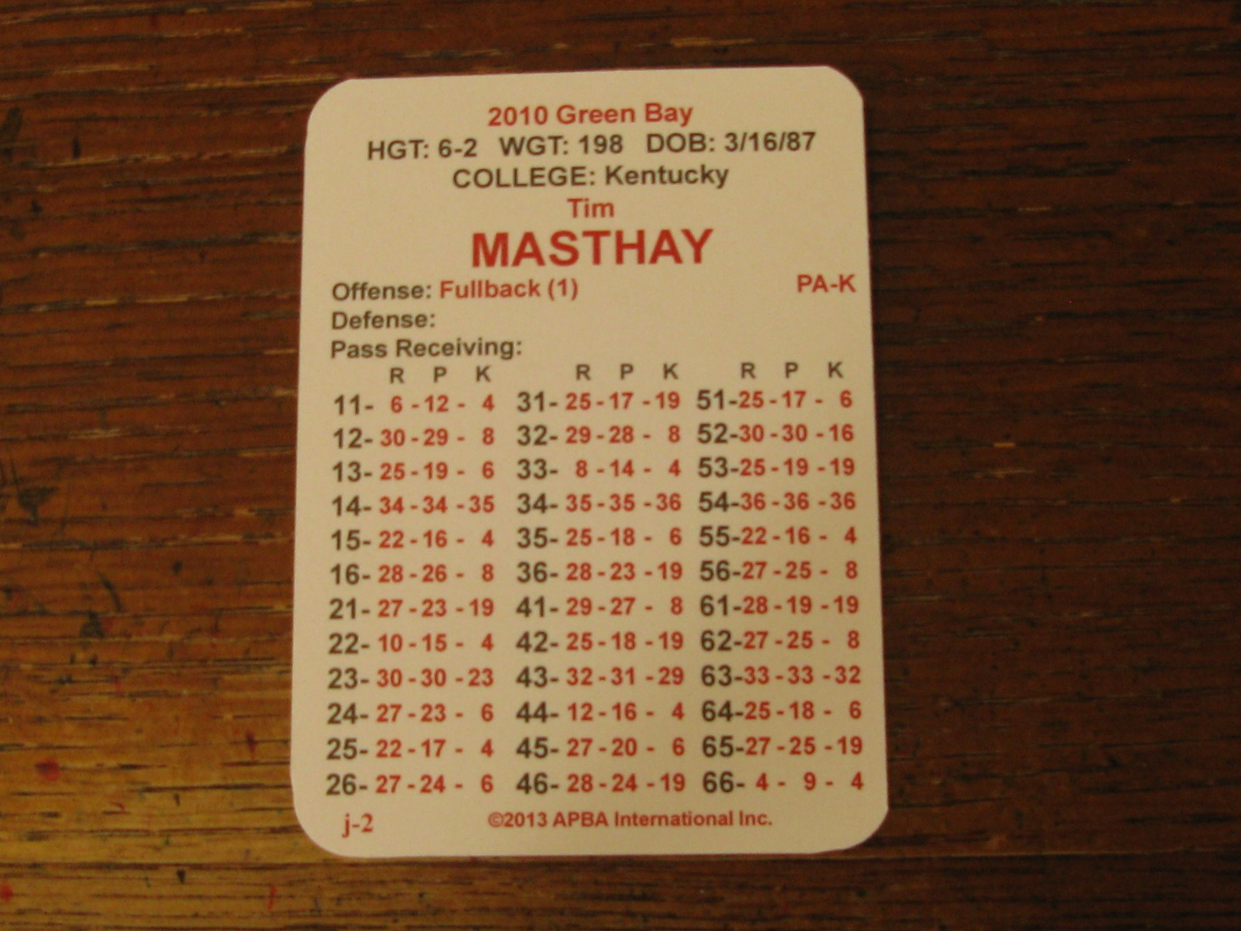
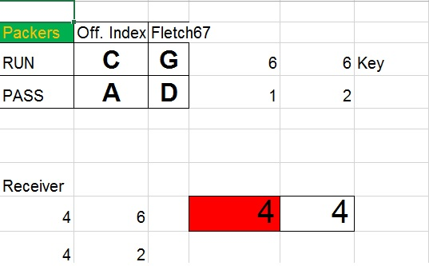
Punt
“PA” designates team’s primary punter. “-K” indicates column to read play result. The dice roll was “44” and the play result is a “4”.

Slide 13
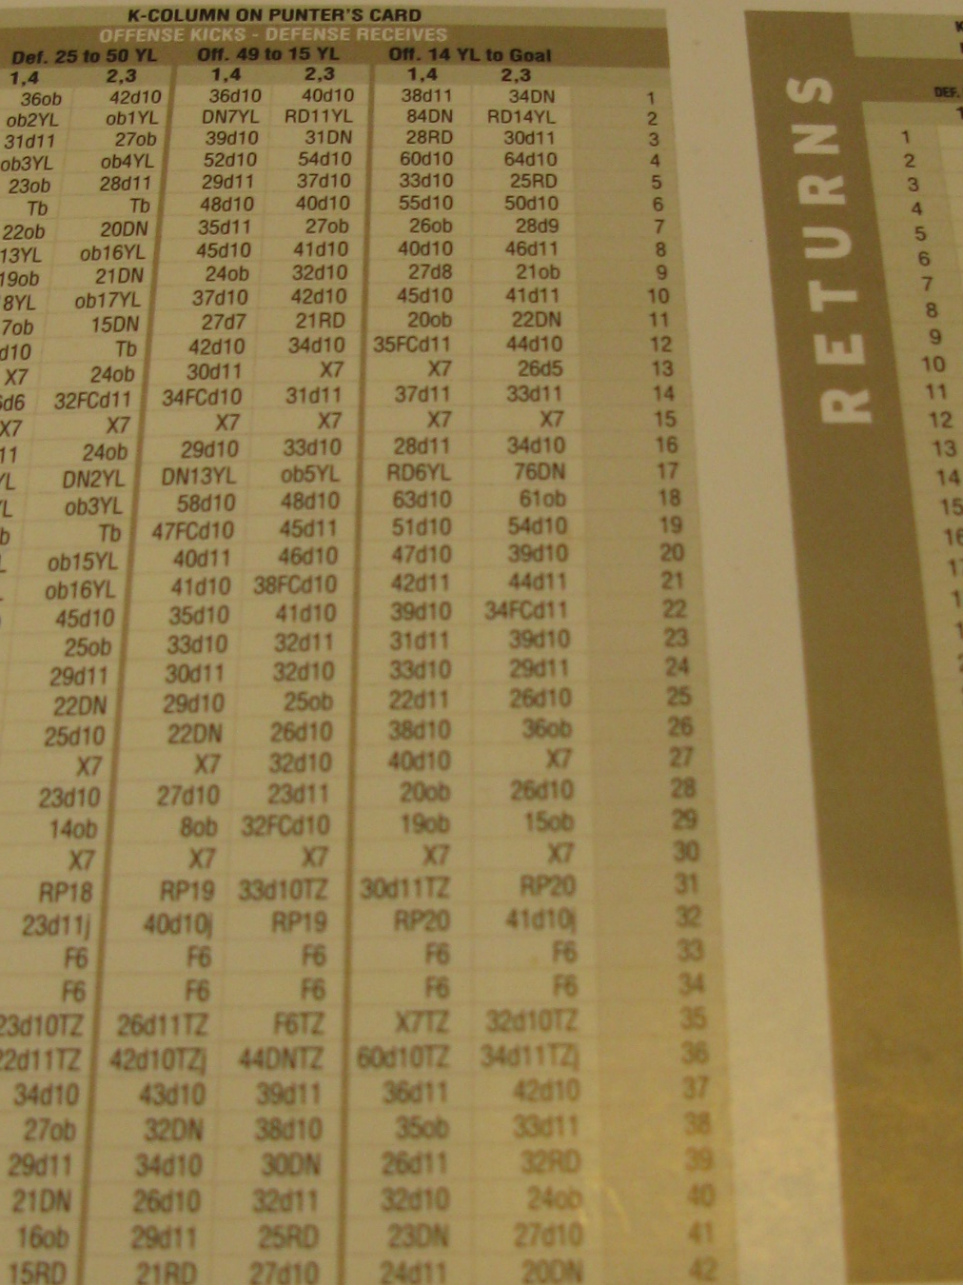
Punt
The play result from the punt table is “60d10”. The “60” indicates Tim Masthay punted a booming 60-yard punt. The punt is measured from the line of scrimmage.

Slide 14
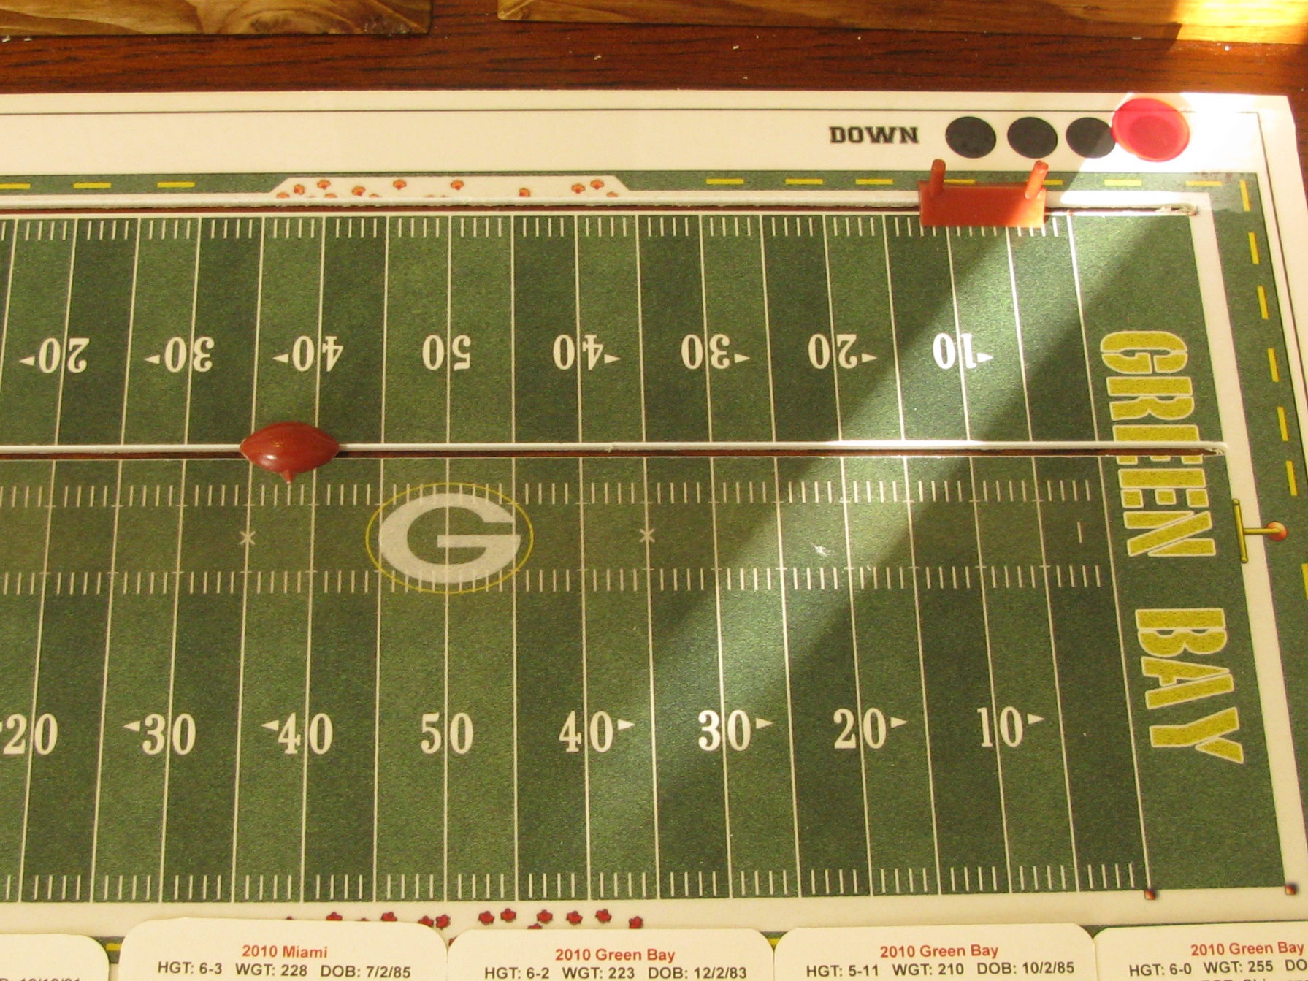
Punt Result
The ball was punted to the Miami 38-yard line.

Slide 15
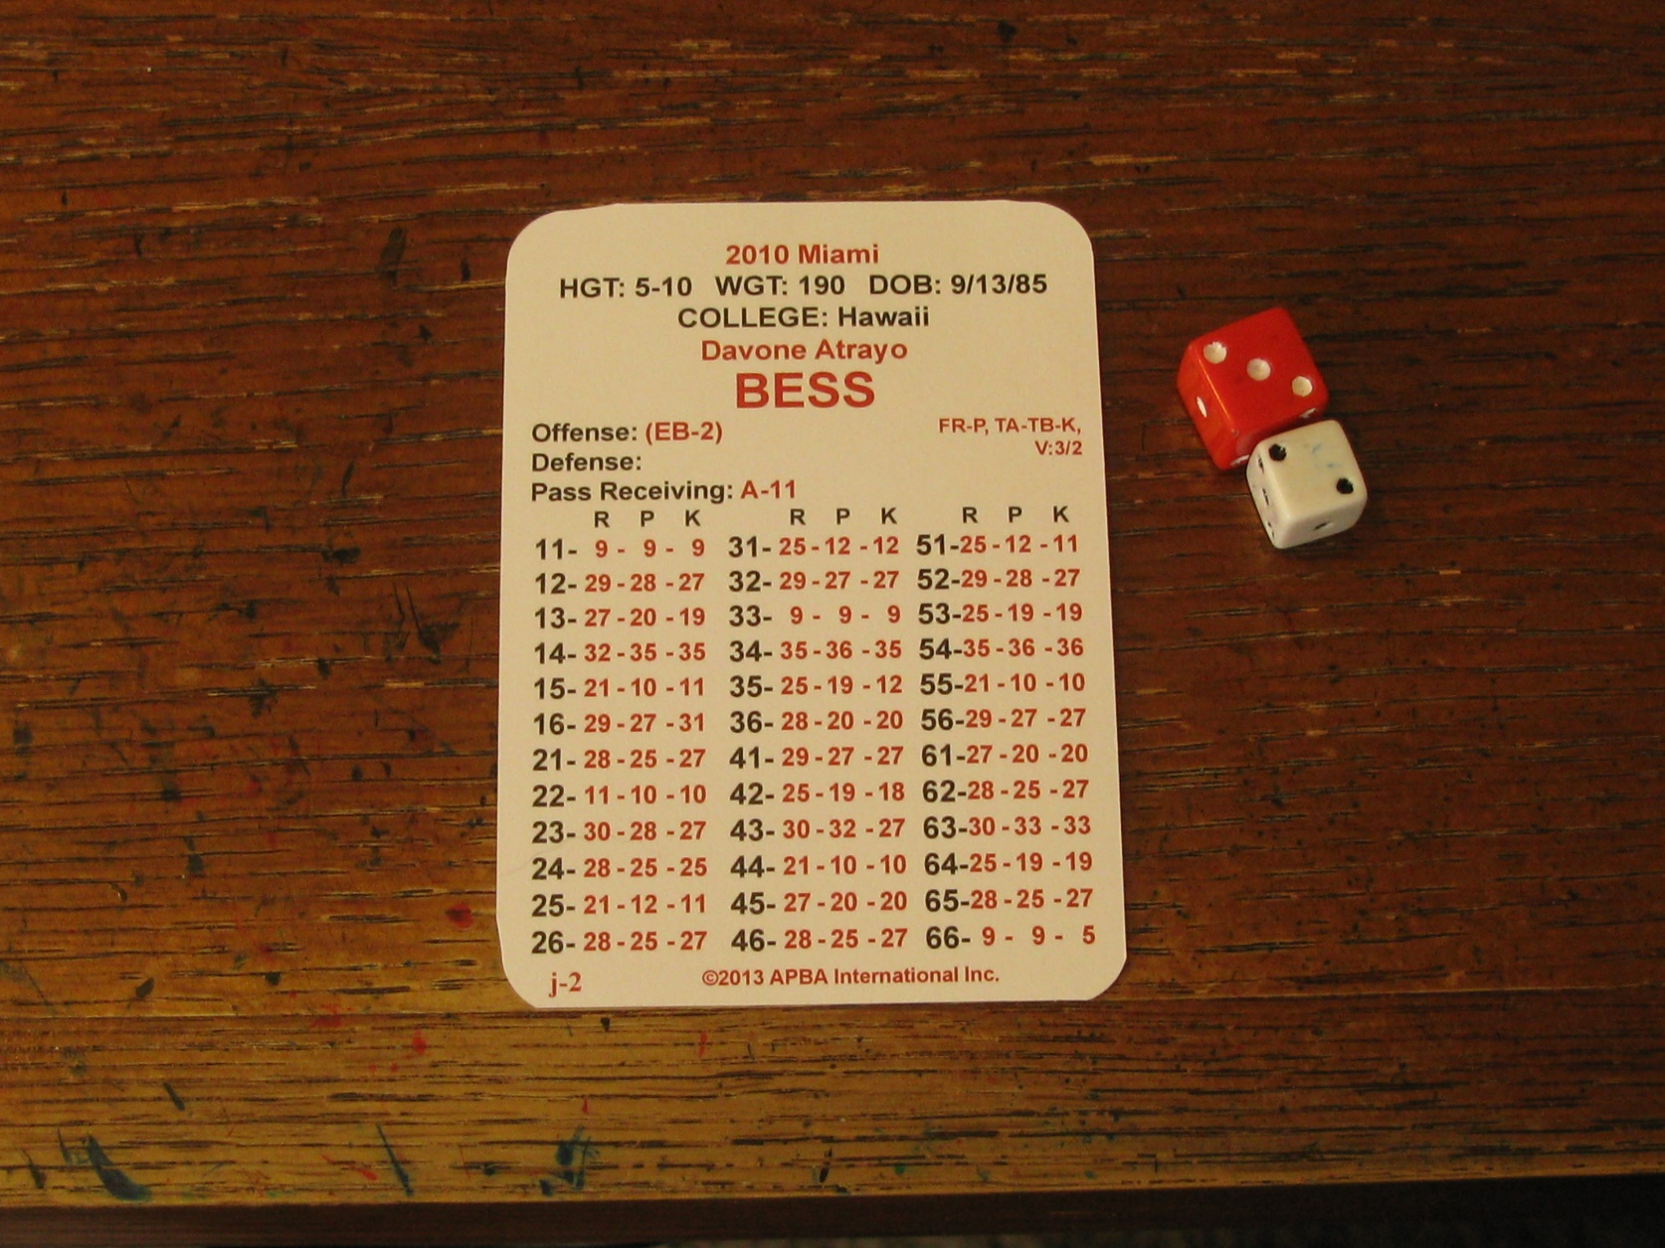
Punt Return
“TA-TB” indicates Bess is the primary (TA) & secondary (TB) punt returner.
Insert a player at the empty roster spot to complete 11-man platoon.

Slide 16
Punt Return
“K” indicates the column to read the play result from.
The dice roll was “32” . The play result is “27”.

Slide 17
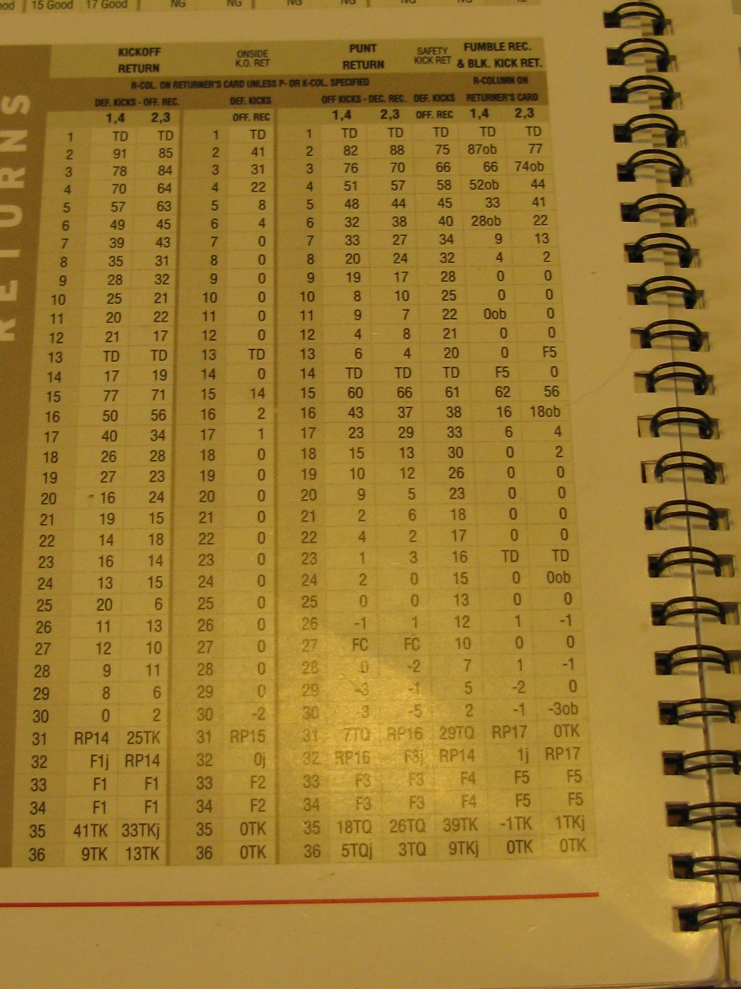
Punt Return
The play result “27” indicates a “Fair Catch” was made by Davone Bess.
Miami will take over at their own 38-yard line.

Slide 18
  NEUTRAL DOWNS

Slide 19
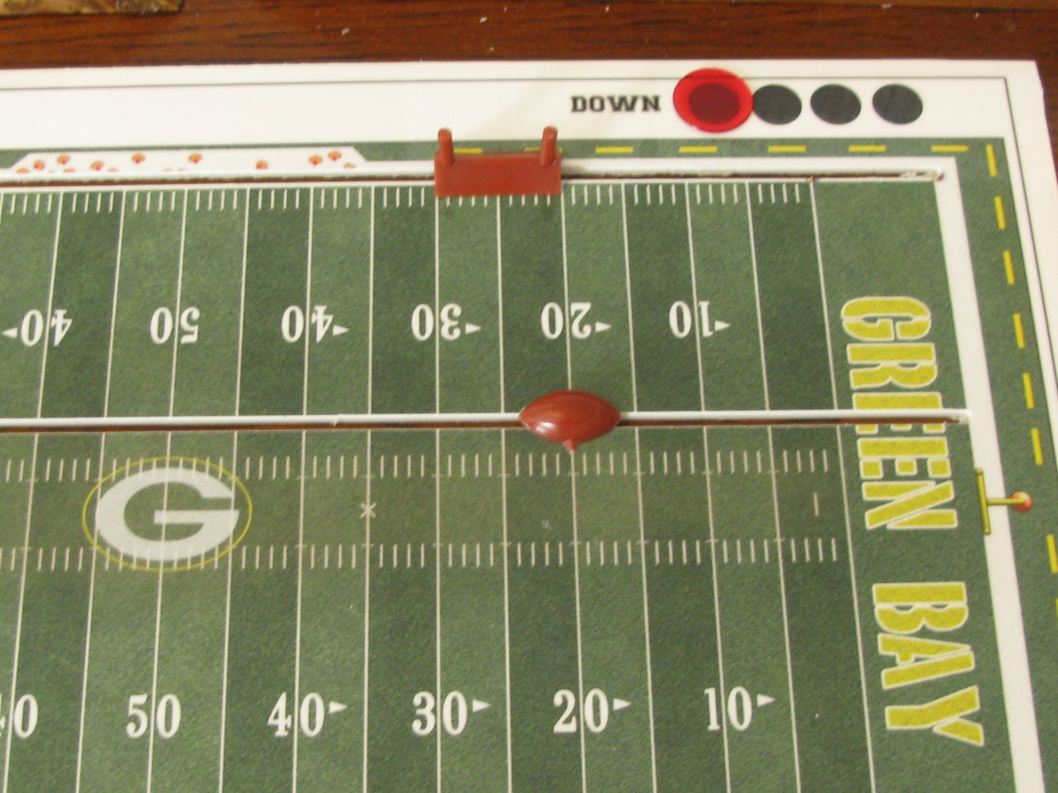
Neutral Down (Run Play)
The play call is an
“Outside Run” to Brandon Jackson.
At the time of the call, the offensive index or defensive alignment is unknown.

Slide 20
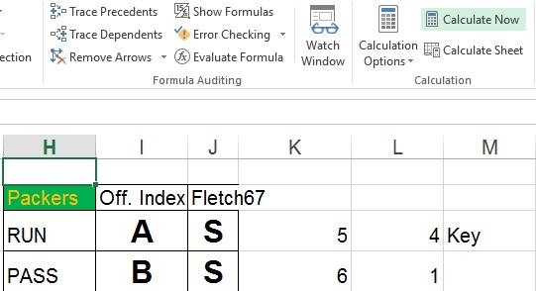
Neutral Down (Run Play)
Refresh the Page
If Miami was in “G” alignment, cross-reference “54” against the Dolphins “12” Key rating against the run. No Key would have occurred since “54” is outside Miami’s key rating of “11” or “12”.
Green Bay will be in “A” index for this play and Miami’s defense will be in “S” alignment

Slide 21
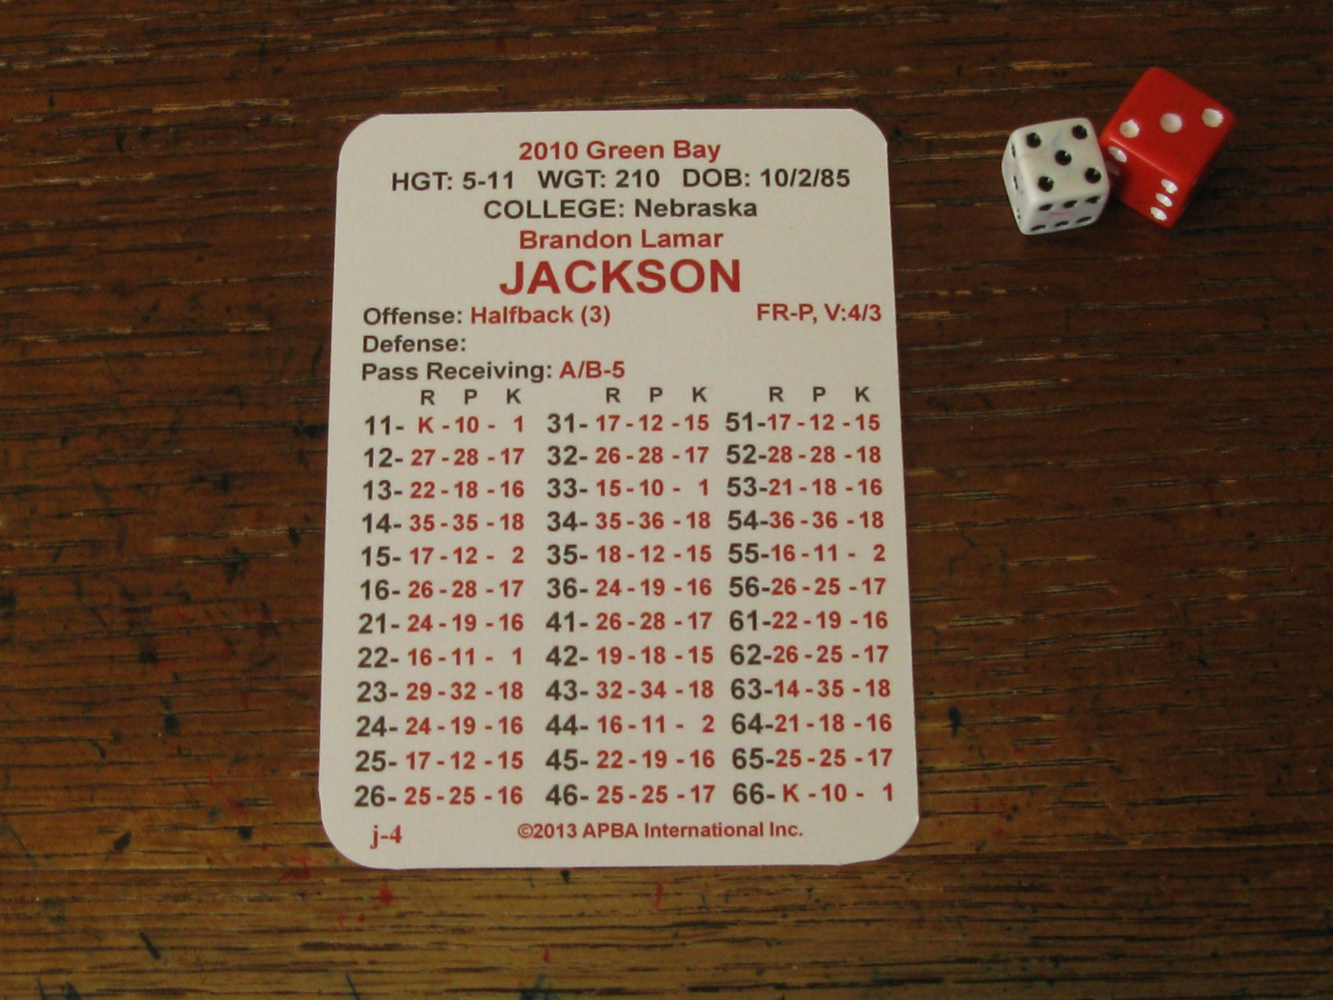
Neutral Down (Run Play)
I only roll the dice to determine play result. Only one roll per play.
Refer to dice roll “35” in “R” column resulting in “18”.

Slide 22
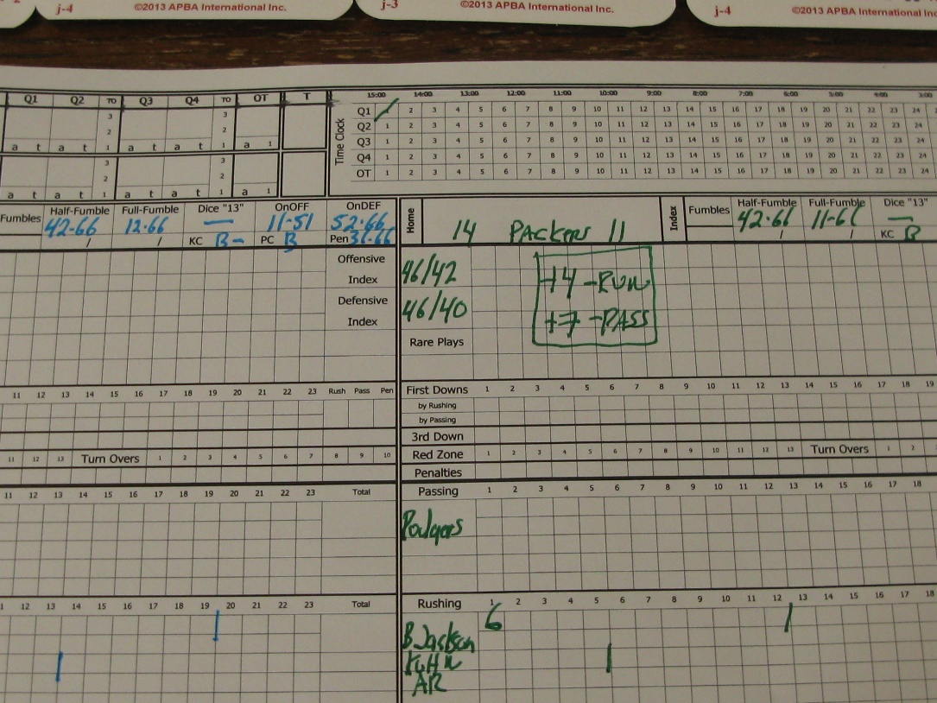
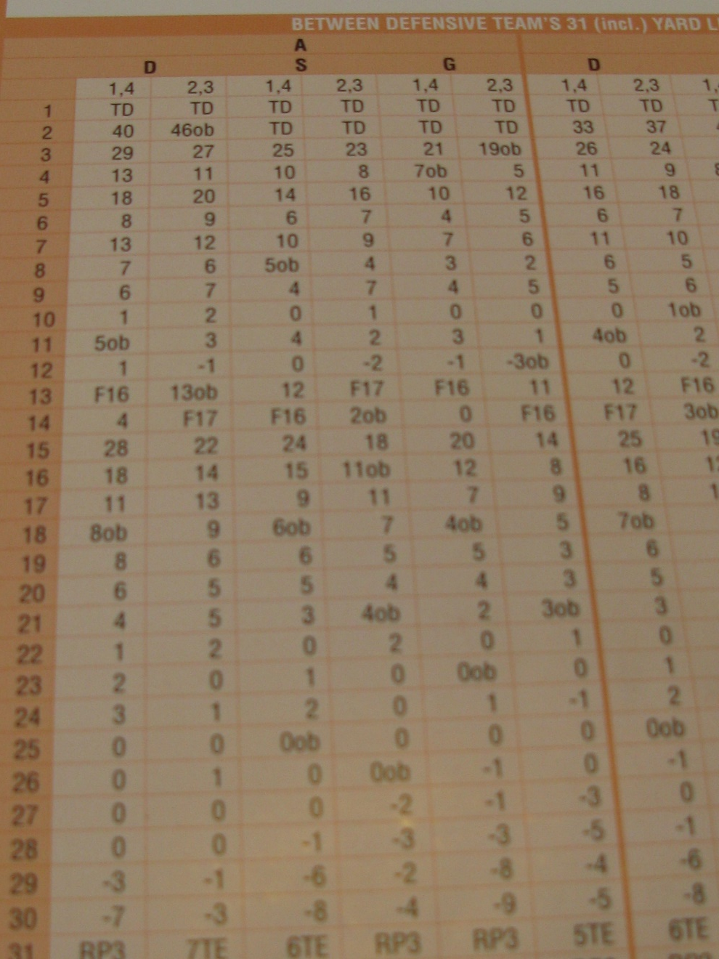
Neutral Down (Run Play)
The Play result is a 6-yard gain. Since the play went out of bounds, you will time this as a “half a play”. Annotate gain in a cumulative manner on scoresheet. Move football and down marker accordingly.

Slide 23
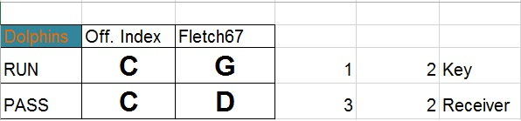
Neutral Down (Keying)
The Play call was an outside run to Ronnie Brown. After refreshing page the above results appeared. Miami is running in “C” index against Green Bay’s “G” alignment.
Since Green Bay is in “G” alignment, there is always the possibility of a “Key”. Green Bay has a Key rating of “14” against the run. The number “12” is within Green Bay’s key rating. Ronnie Brown is keyed on the play.

Slide 24
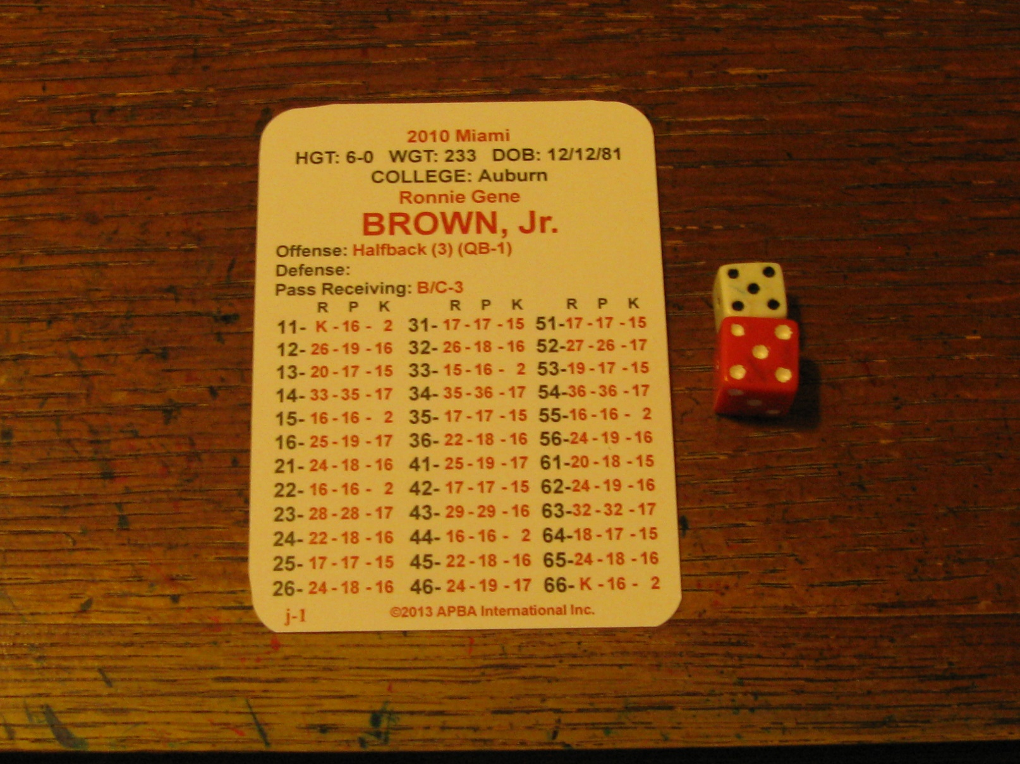
Neutral Down (Keying)
Dice Roll “55” results in play result “16” from R. Brown's “R” column.

Slide 25
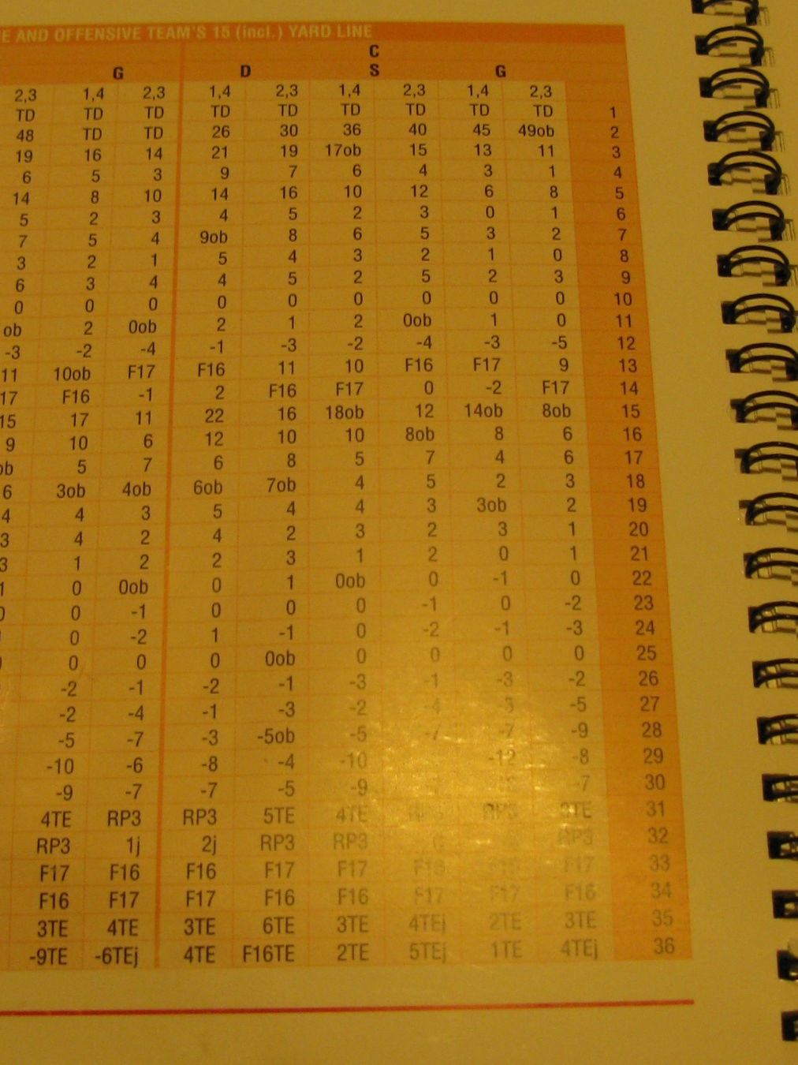
Neutral Down (Keying)
Play Result “16” would have been an “8-Yard” gain, however, Green Bay keyed R. Brown resulting in a two-line drop.
The new play result is a “2-yard” gain. This is a difference of six yards.
Annotate scoresheet and move ball and Down marker accordingly.

Slide 26
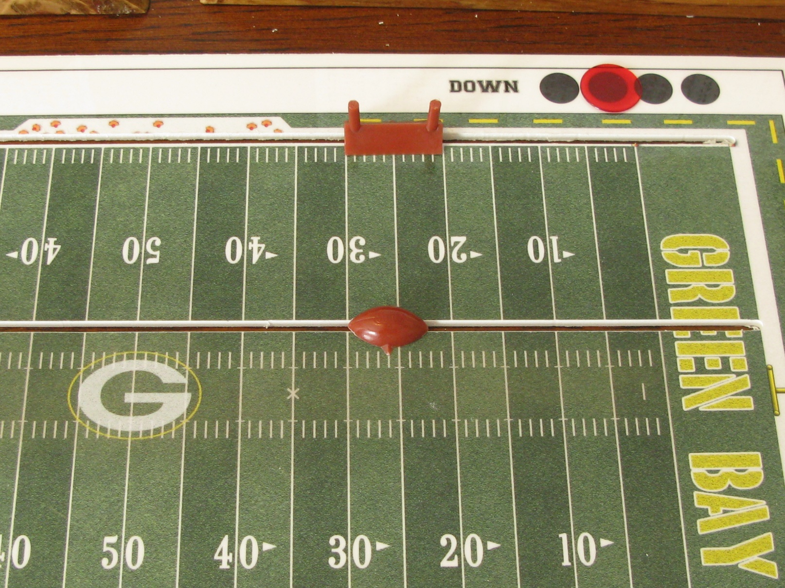
Neutral Down (Pass Play)
The play call is a “Short Pass”.
At the time of the call, the offensive index, defensive alignment or intended receiver is unknown.

Slide 27
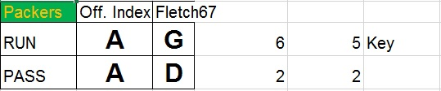
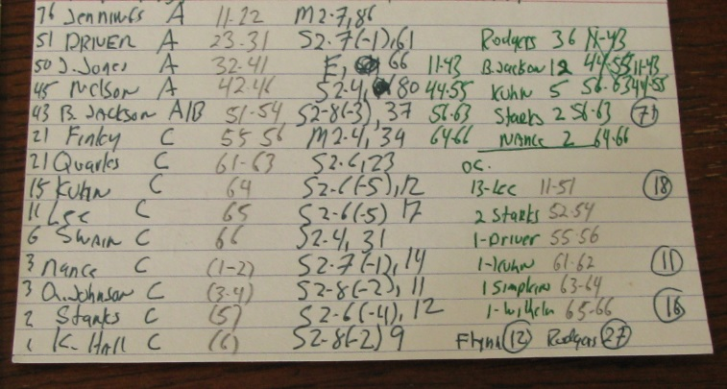
Neutral Down (Pass Play)
Green Bay has a Pass index of “A”. Miami is in “D” alignment. Miami has a “13” pass key rating. Since “65” is outside this range there is no double coverage.
The intended receiver is “22”. Cross-reference team card and Greg Jennings is the intended receiver.
Since he is an “A” receiver, the index will remain in “A” for this play.

Slide 28
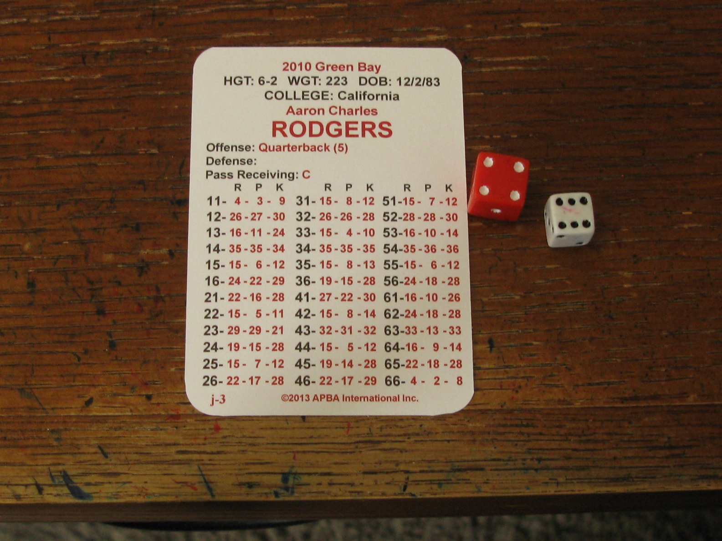
Neutral Down (Pass Play)
I only roll the dice to determine play result. Only one roll per play.
Refer to dice roll “46” in “P” column resulting in “17”.

Slide 29
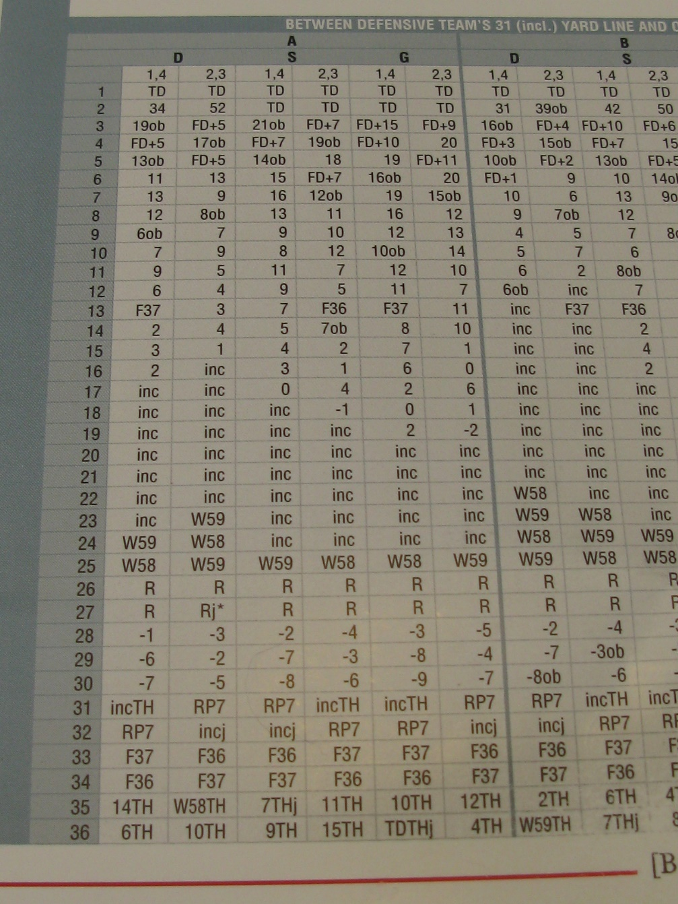
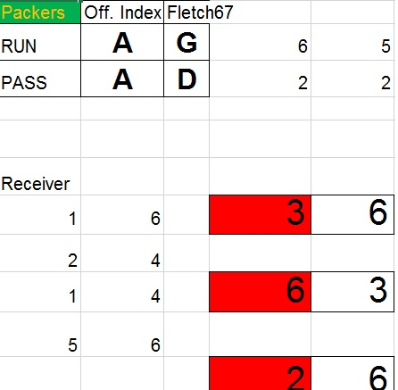
Neutral Down (Pass Play)
The play result is a completion to Greg Jennings for no gain. Since Miami has a positive sack rating of “12”, I check the top row of additional dice rolls to see if a sack occurred. Since this is outside the range, no sack. If it was either an “11” or “12” it would be a sack and play read from line “29”.

Slide 30
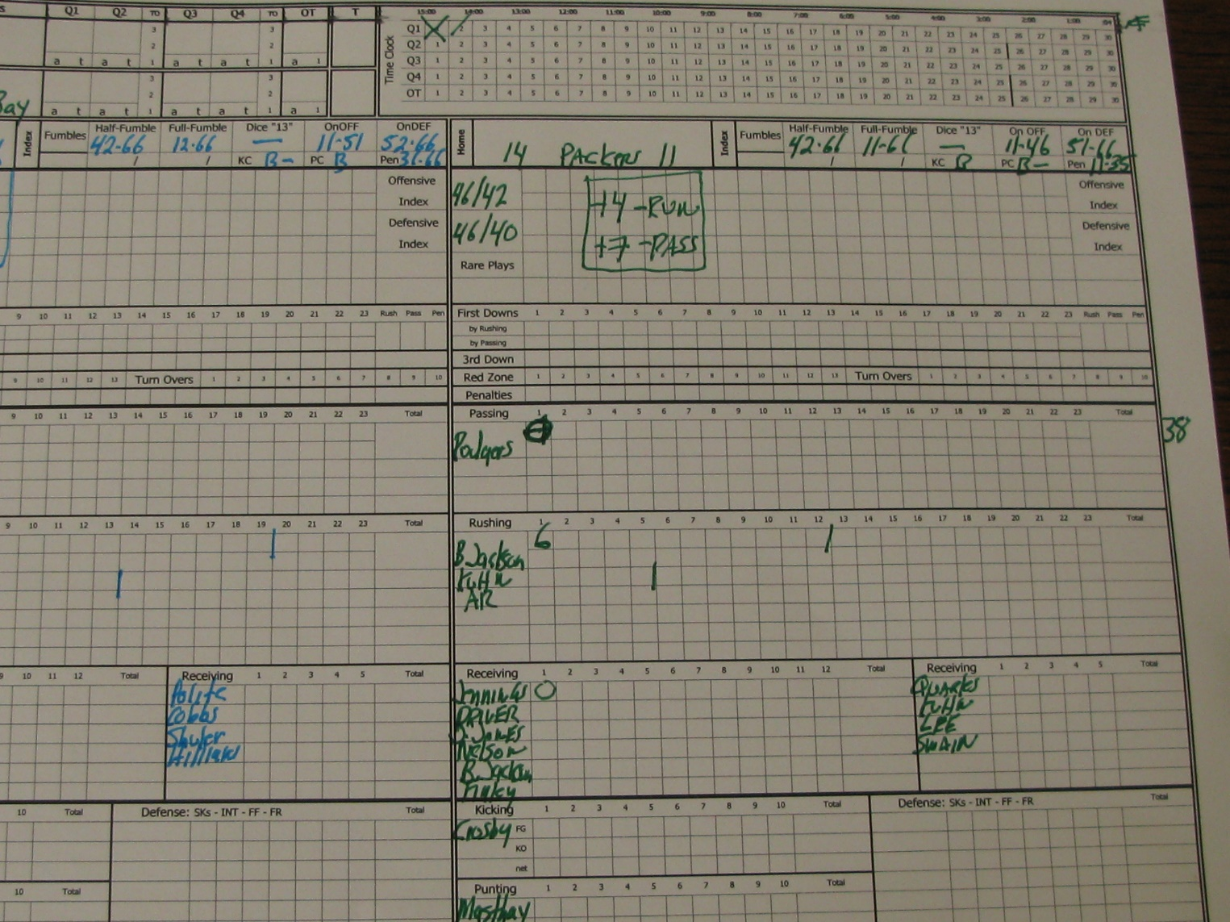
Neutral Down (Pass Play)
Since the pass was a completion and it was in bounds, it’s timed as a “Full Play”.
Update scoresheet accordingly.
Since it was no gain, leave football at current position but move “Down” marker to third down.

Slide 31
  TRICK PLAY

Slide 32
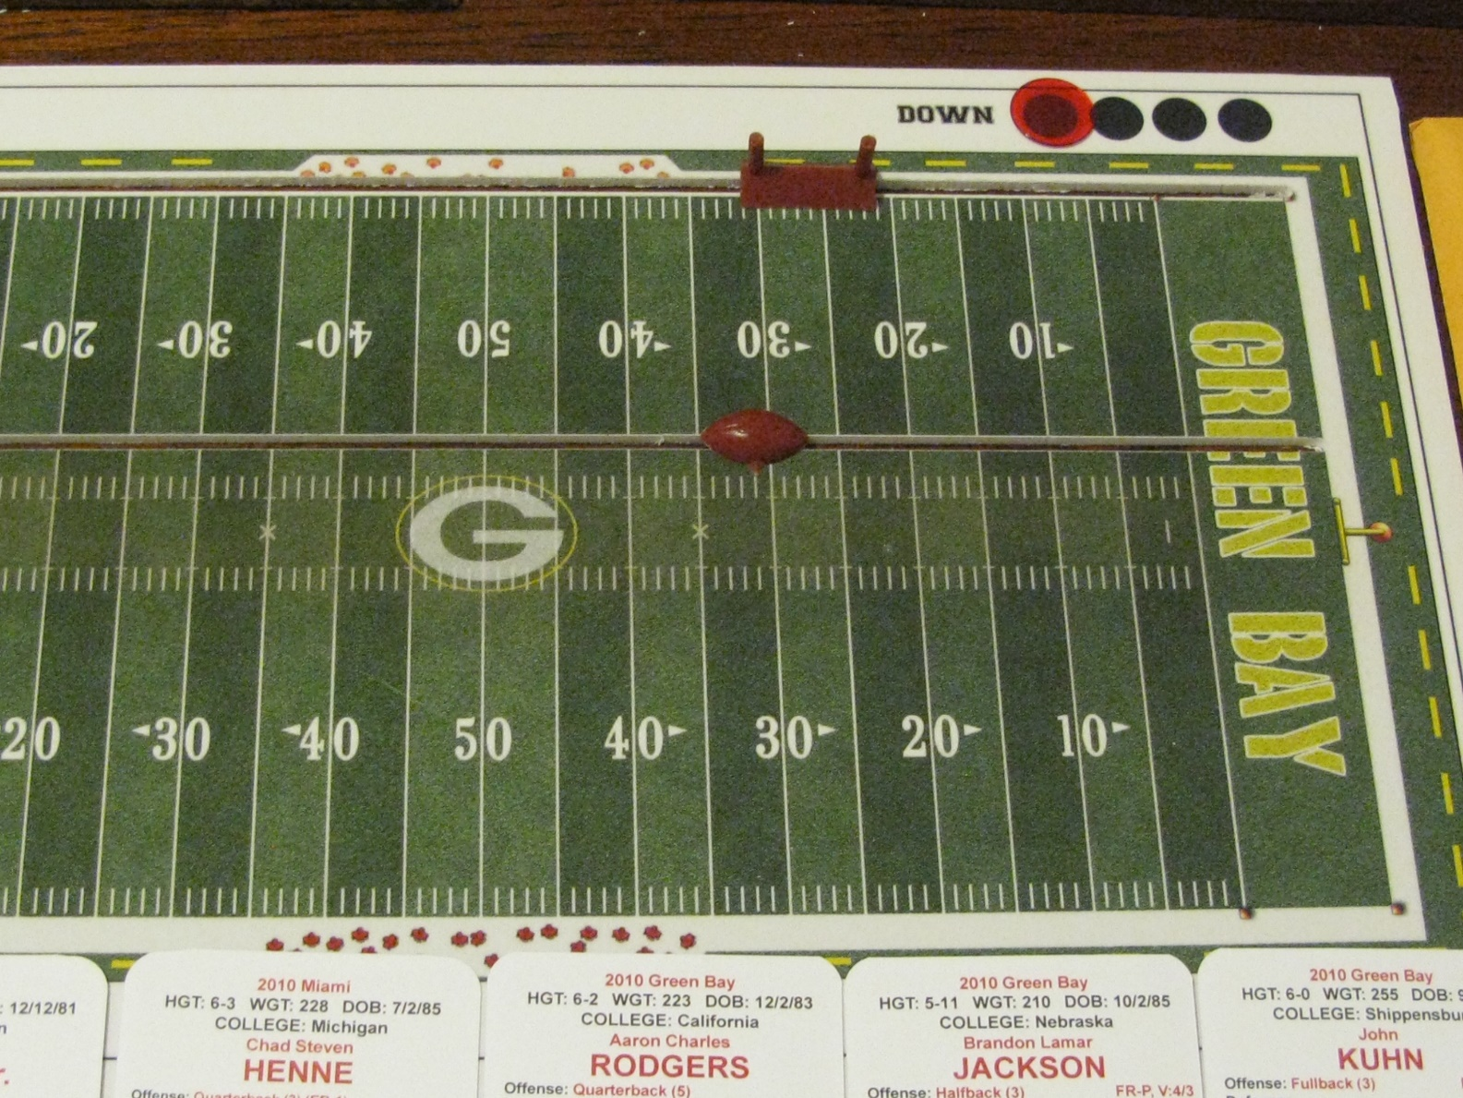
Trick Play
Miami has 1st & 10 at GB 31-yard line. B. Hartline had a carry in actual game, so I thought it was a good time to dial up an “end around”.
On offense, you may call a Trick Play once each half. No single Trick Play can be used more than once per game.

Slide 33


End Around
Miami is in “B” index for this Trick Play
If there is a dice roll of 11, 33, or 66 a Trick Play defense was automatically called resulting in a 7-yard rushing loss for B. Hartline.
Since none of those numbers appeared the trick play is on.

Slide 34
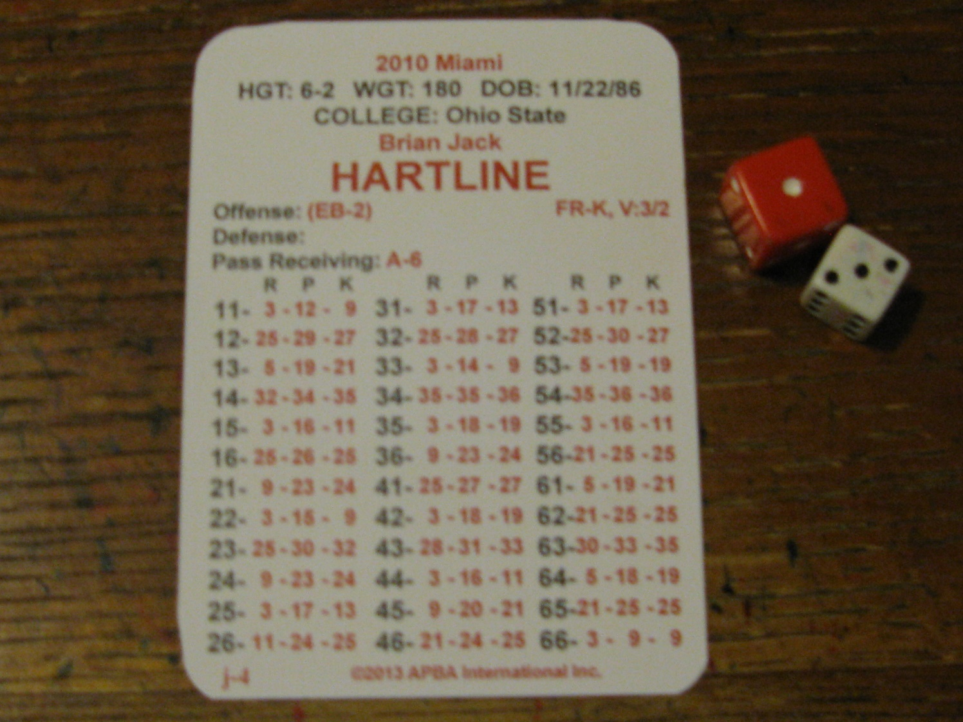
End Around
The play result of dice roll “13” was a “5” on his “R” column.

Slide 35
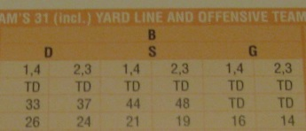
End Around
On called trick play runs (bootleg or end around), read the number 2 LINES ABOVE THE CARD NUMBER on the boards for the result. ALWAYS IN D-COLUMN. The play result for B. Hartline is a 26-yard gain.
If the card number is 1, 13, or 21 – 36, use it. Don’t include number 13 in counting lines. If your line change would take you through 1, use 1.

Slide 36
  SITUATIONAL DOWNS

Slide 37
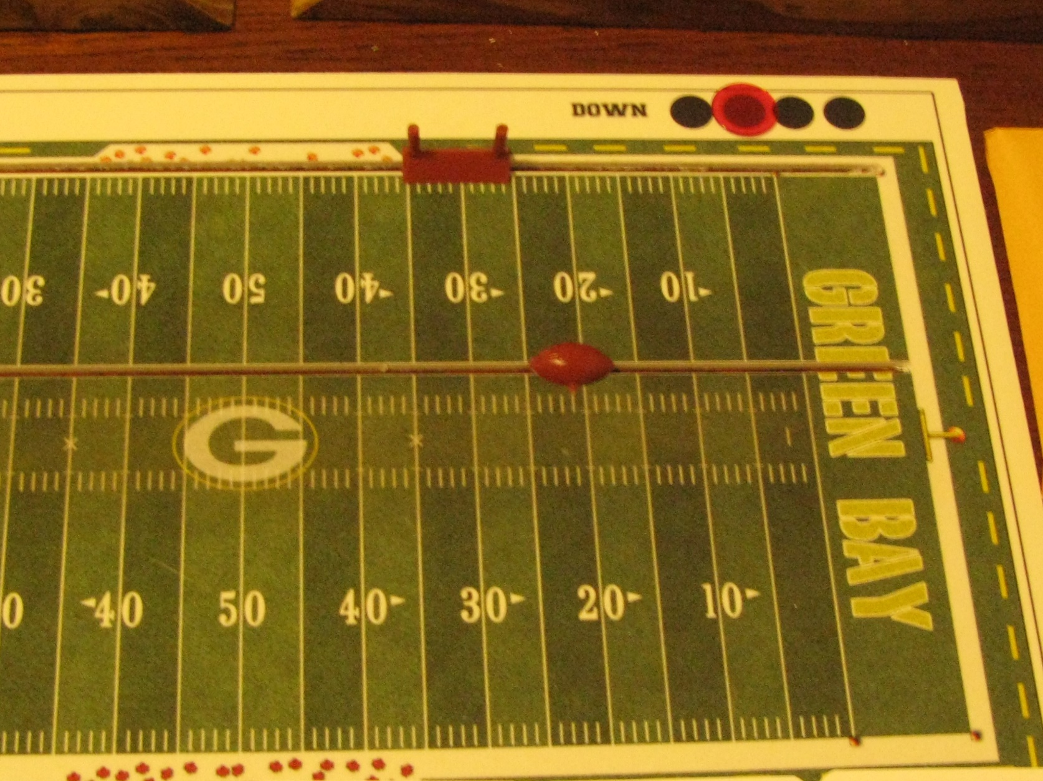
2nd & Long
On Green Bay’s third offensive series of the first quarter they were faced with 2nd & 14 from -21.
Play call was a short pass, however, the offensive index, defensive alignment & receiver was unknown.

Slide 38
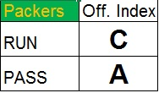
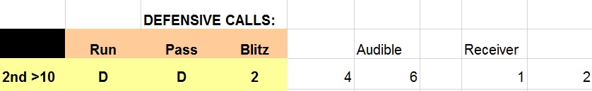
2nd & Long
Green Bay’s Pass Index is “A”.
2nd & Long
Miami’s “Nickel” defense was in “D” alignment. No blitz on dice roll 1 – 5, only 6. Whenever defensive is in “D” alignment check for audible (dice roll 46). Only dice rolls 11 – 16 are audibles, no audible on this play. Determine intended receiver by checking number (12) listed underneath Receiver.

Slide 39
2nd & Long
The number “12” falls within Greg Jennings dice roll allocation range of “11-22”. Greg Jennings is an “A” rated receiver, however, he is facing a “Nickel "defense. Since he does not have an asterisk associated with his “A” rating, the reduction rule comes into effect lowering the passing index by one (i.e., A to B).

Slide 40
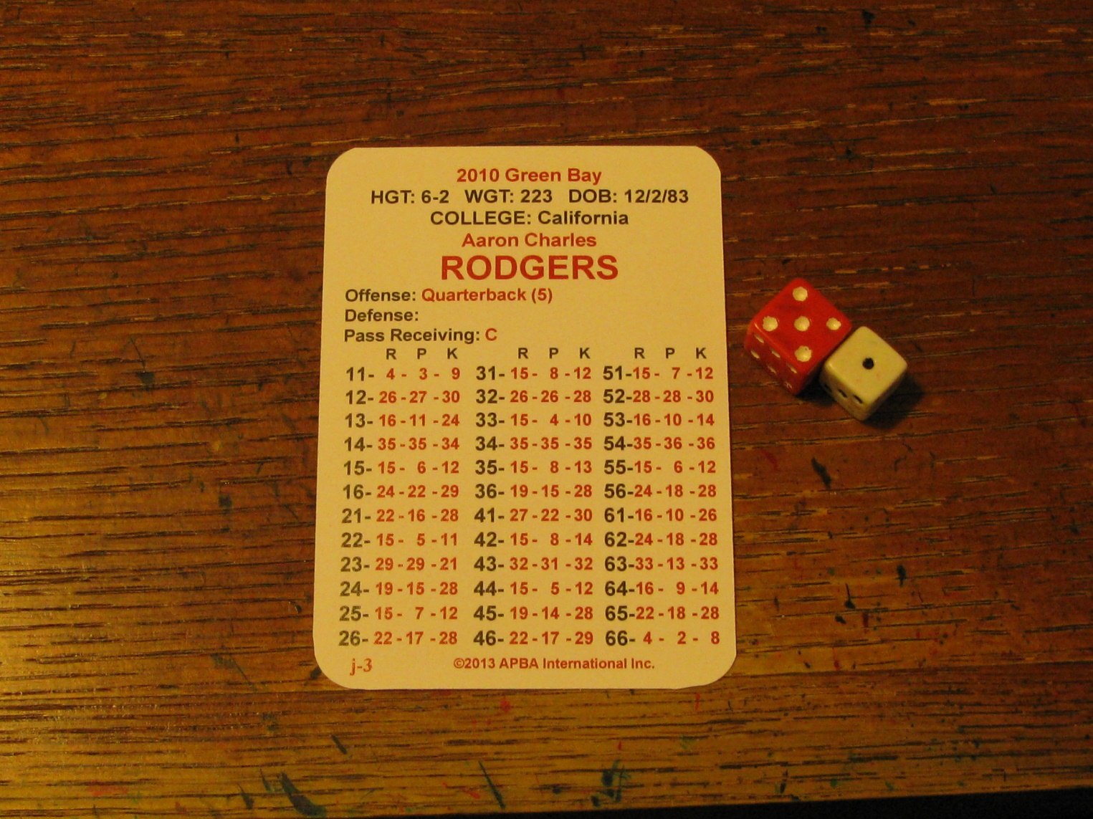
2nd & Long
A dice roll “51” results in a “7” in A. Rodger’s “P” column.

Slide 41

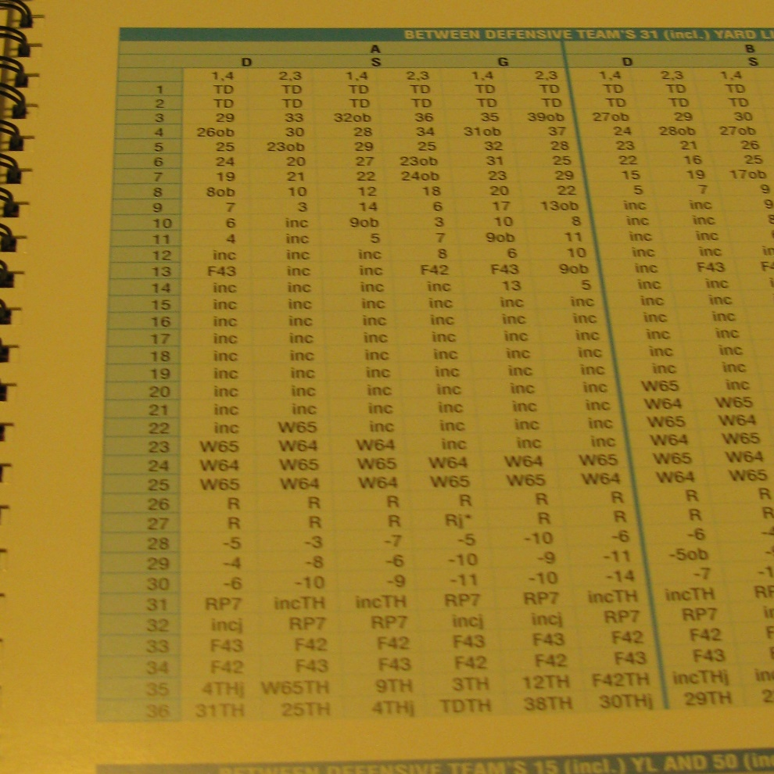
2nd & Long
The play call was a short pass and the play result was “7”. First, check Short Pass boards to determine if the pass is complete. The pass was complete, but, Greg Jennings has a YPC rating of M2-7, 86 resulting in the play being read from the Medium instead of the Short board. The catch netted 5 additional yards (10 to 15).

Slide 42
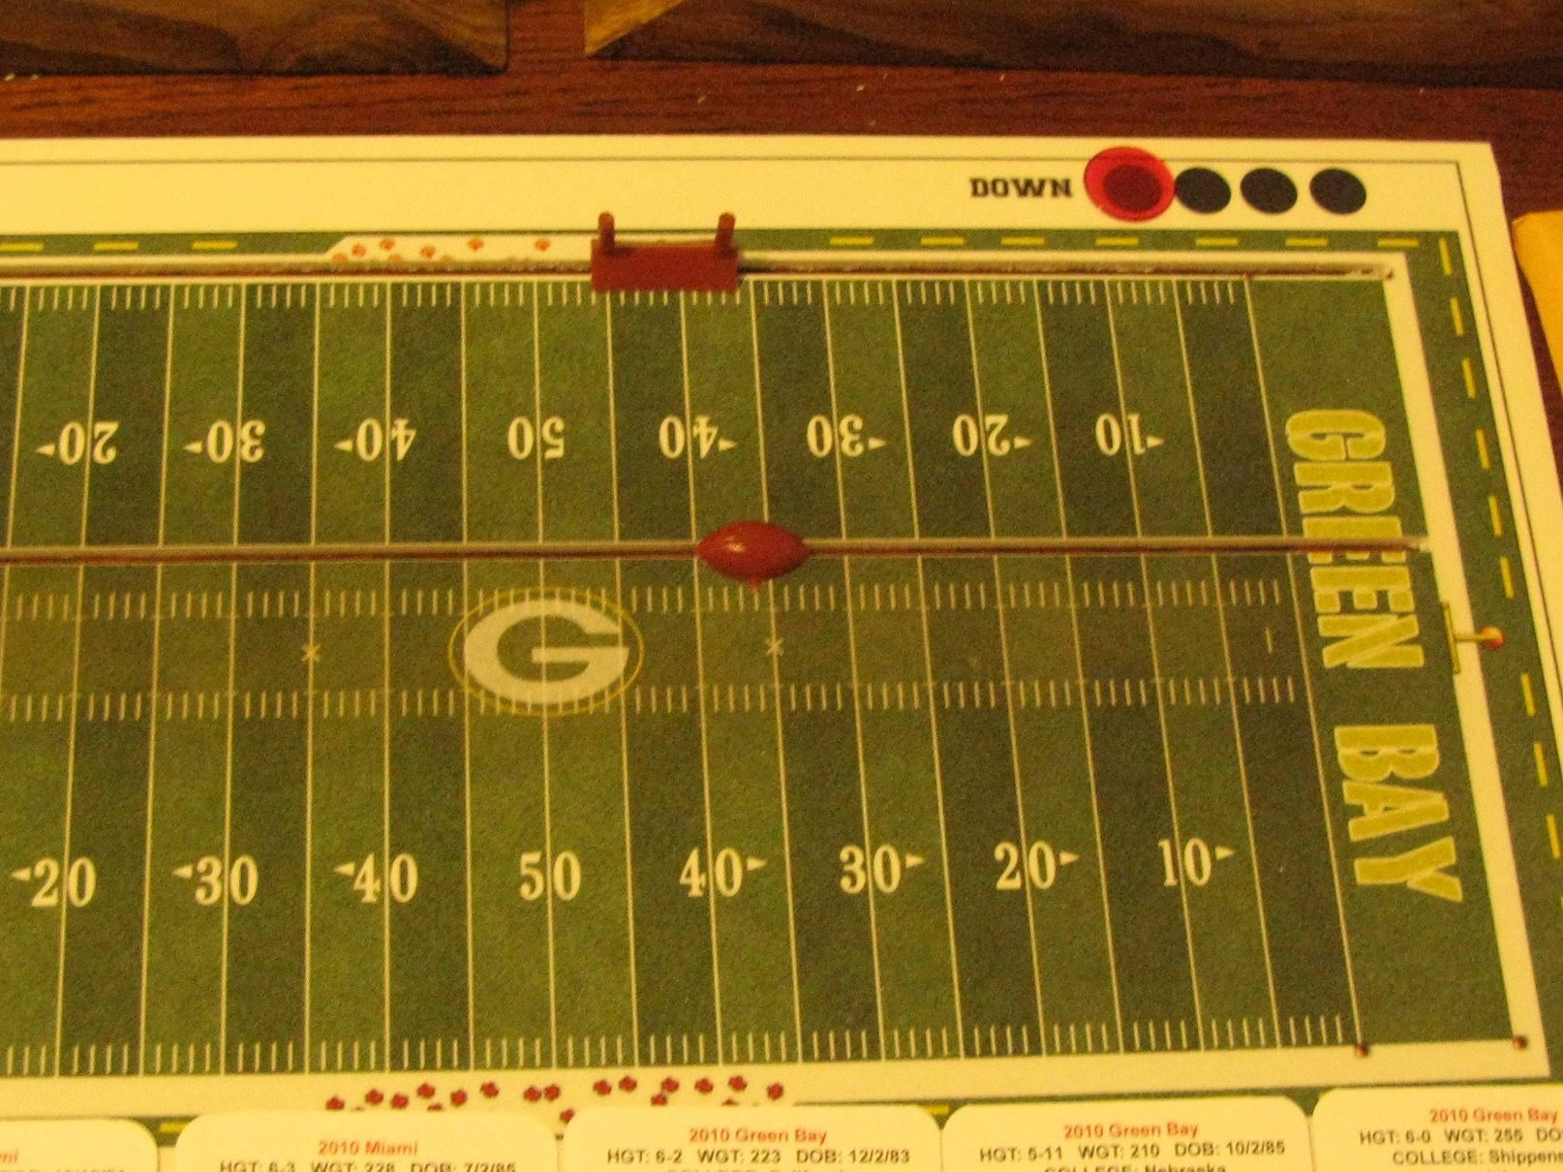
2nd & Long
Green Bay converted a 2nd and 14 with a 15-yard pass from A. Rodgers to G. Jennings.
Move ball & first down marker.
Update scoresheet accordingly.

Slide 43
Situational Down & Distance
Repeat the identical steps for a 3rd down & medium (3rd & 5 to 7 yards) situation
The steps are the same for a 3rd and long (8 or more yards), except:
  Offense is in their “3-WR” package
  Defense goes to their 6-db “Dime” defense
As a reminder, if the intended receiver has an asterisk associated with the short or medium/long pass ratings (i.e, A*/A, A/A*, or A*/A*) the reduction rule is ignored

Slide 44
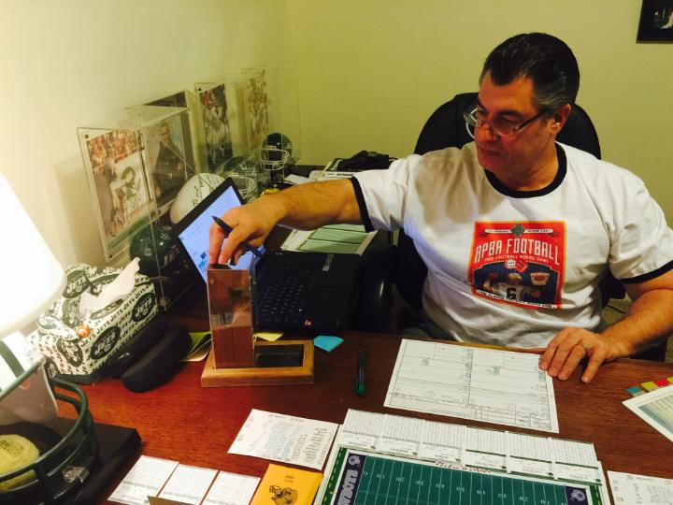
Conclusion
This presentation is designed to augment APBA Football
Tutorial 3.0. For questions or concerns, please, contact me at Oguard62@yahoo.com

