Slide 1
Blitzing alternative
In APBA, what is the primary purpose of blitzing?
  Willing to gamble to get a better pash rush
  Defense automatically in D-alignment
“P” column result from QB’s card is 1-12 (Traditional Technique)
  If opponent called a pass play, including screen pass and card number is 13, 21-36 use it
  If it’s another number, drop two lines (do not count PRN 13) from the “P” column result on the QB’s card
  If line change takes you to 21, use 30 and add an additional 3-yards
  If pass is still complete after dropping two lines, go up two lines from original result
    P-column is 6, 2-line drop to 8 remains complete, use 4 as the result
    Use 1, if your line change takes you there
    Use the YPC rules if this takes you to 1 or 2

Slide 2
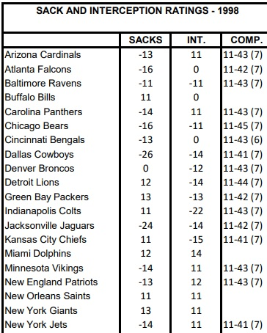
Blitzing alternative
P- column result 14-19, 26 & 27 the QB is hurried by the BLITZ
  DO NOT make the down 2 adjustment
  Check for a possible SACK after adjusting the defensive teams sack rating +5
    If the rating is positive after the adjustment check for a sack (Adjust Vikings defense from
    -14 to +12)
      If the roll is in range (11 or 12)then a SACK has occurred, treat as PRN 30, add an additional 3 yards
      If the roll is outside the range (13 – 66) then the pass is INCOMPLETE

Slide 3
Blitzing alternative
P- column result 14-19, 26 & 27 the QB is hurried by the BLITZ
  If the rate is negative after the adjustment (Bears -16 to -11), check for a completion but subtract 5 from the defensive team's completion rate (Adjust Bears defense’s completion rate from 11-45 to 11-36)
  If the dice roll still falls within the adjusted completion rate (11-36) then the pass is complete
  Number in parenthesis is board result (7)
    Add 5 yards to the gain
  If the roll is outside the range (41-66) then the pass is INCOMPLETE

Slide 4
Blitzing alternative
P- column result 28-30 are automatic SACKS if the adjusted sack rating is positive
If the adjusted rating is negative, roll against the adjusted rating to determine if the SACK stands
  Using Bears as an example (i.e., -16 becomes -11)
    Dice rolls 12 – 66 would result in a sack
    If dice roll falls within new sack rating (11), check to see if the pass is completed
    If the dice roll still falls within the adjusted completion rate (11-36) then the pass is complete
    Use board result in parenthesis (7) and add 5 yards to the gain
    If the roll is outside the range (41-66) then the pass is INCOMPLETE

Slide 5
Blitzing alternative
Treat PRN 20 as a 28 but follow all the SACK procedures outlined above
If an inside or outside running play was called read the number 2 lines above the card number on the boards
    If the card number is 1,2,3,4,13,14,15 or 28 through 36 use it
    If the card number is 24,25,26, or 27 read the number 28 for the result
On Draw plays add 5 yards to any gain and use 30 for card numbers 24 through 29

